Slide 1

Data Visualization Session I
Tami Tang
06/25/2021

Slide 2
What’s Data Visualization
“Data visualization is an interdisciplinary field that deals with the graphic representation of data. ”--Wikipidia

Slide 3
Why Data Visualization?
Answer questions about your data
Make decisions
Find patterns
Present an argument or to tell a story

Slide 4
Data Visualization Design Process
Tell a story with data
Think like a designer
Draw attention where you want it
Eliminate clutter
Choose effective visuals
Understand the context
Notes:
In this session, we will focus on the first two steps.

Slide 5
Understanding the Context
Whom are you communicating?
What do you want your audience to know or do?
How can you use data to help make decisions?

Slide 6
Understanding the Context
Who?
“The budget committee that can approve funding for continuation of the Summer learning program.”
What
“The summer learning program on science was a success, please approve budget of $X to continue.”
How
“Illustrate success with data collected through the survey conducted before and after the pilot program”

Slide 7
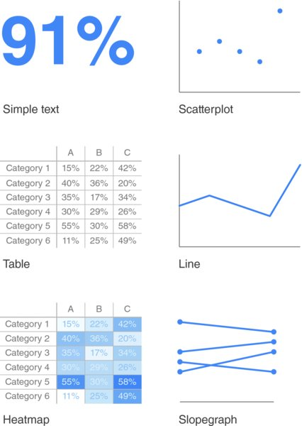
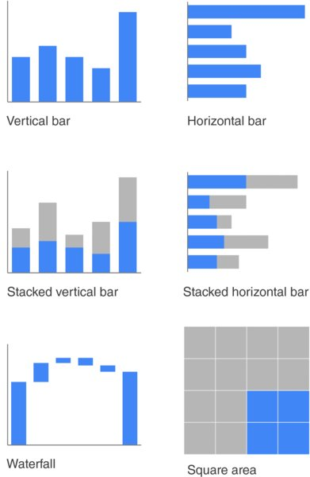
Choosing Effective Visuals

Slide 8
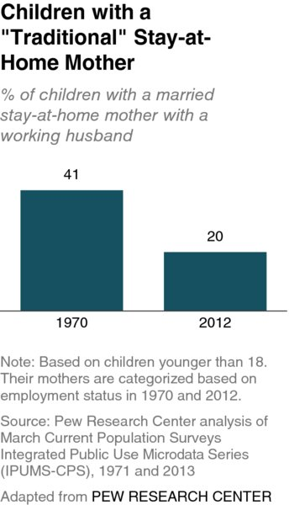
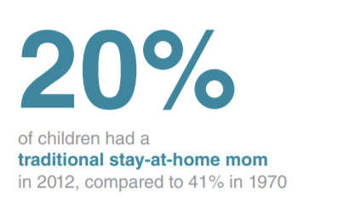
Simple Text
Use simple text when you just have a number or two to share, simple text can be a great way to communicate.
VS
Notes:
Think about solely using the number— making it as prominent as possible—and a few supporting words to clearly make your point

Slide 9
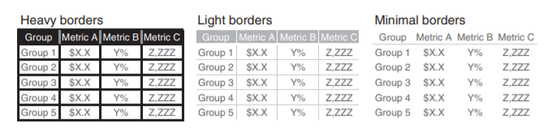
Tables
Use table when communicate to a mixed audience whose members will each look for their particular row of interest. OR Need to communicate multiple different units of measure.
The data should stand out, not the borders
Notes:
Tables are great for just that—communicating to a mixed audience whose members will each look for their particular row of interest. If you need to communicate multiple different units of measure, this is also typically easier with a table than a graph.

Slide 10
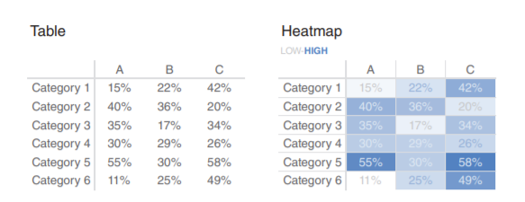
Heatmap
Use heatmap to help our eyes and brains more quickly target the potential points of interest.

Slide 11
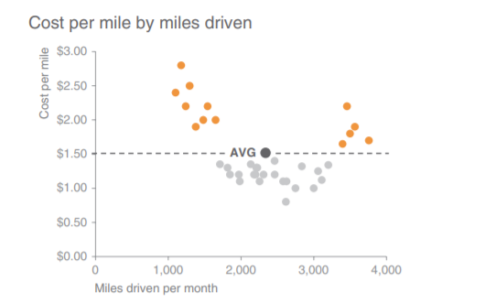
Scatter plot
Use scatterplots when you need to show the relationship between two things.

Slide 12
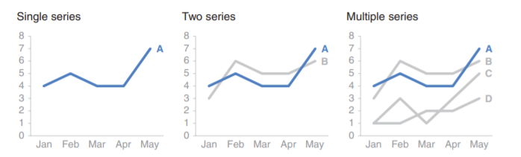
Line
Line graphs are most commonly used to plot continuous data.

Slide 13
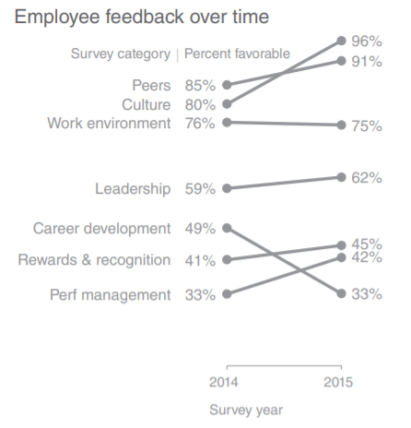
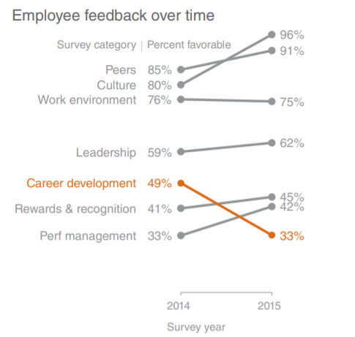
Slopegraph
Slopegraphs can be useful when you have two time periods or points of comparison and want to quickly show relative increases and decreases or differences across various categories between the two data points.

Slide 14
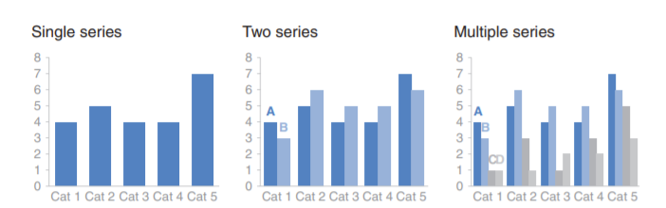
Vertical Bar Chart
Vertical bar chart is easy for our eyes to read. Must have zero baseline!
Be cautious with multiple series

Slide 15
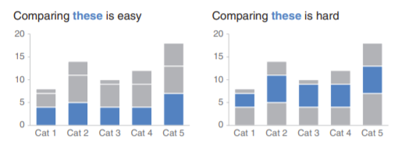
Stacked Vertical Bar
Use stacked vertical bar to compare totals across categories and also see the subcomponent pieces within a given category. (limited use cases)
Notes:
It is hard to compare the subcomponents across the various categories once you get beyond the bottom series (the one Bars 55 directly next to the x‐axis) because you no longer have a consistent baseline to use to compare. This makes it a harder comparison for our eyes to make

Slide 16
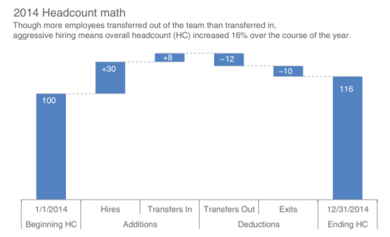
Waterfall
Use waterfall chart to pull apart the pieces of a stacked bar chart to focus on one at a time, or to show a starting point, increases and decreases, and the resulting ending point.

Slide 17
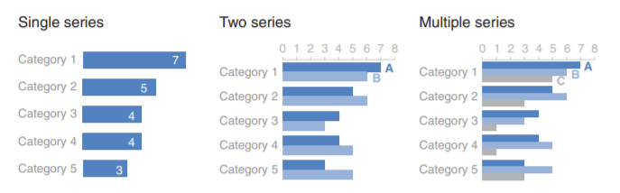
Horizontal Bar
The go-to graph for categorical data. Extremely easy to read.
Be cautious with multiple series
Notes:
Because of the way we typically process information—starting at top left and making z’s with our eyes across the screen or page—the structure of the horizontal bar chart is such that our eyes hit the category names before the actual data.
Your audience (without other visual cues) will typically look at your visual starting at the top left and zigzagging in “z” shapes. This means they will encounter the top of your graph first. If the biggest category is the most important, think about putting that first and ordering the rest of the categories in decreasing numerical order. Or if the smallest is most important, put that at the top and order by ascending data values.

Slide 18
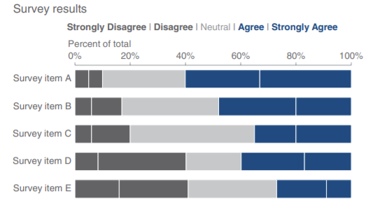
Staked Horizontal Bar
Use staked horizontal bar to show the totals across different categories but also give a sense of the subcomponent pieces. (better than staked vertical bar due to consistent baseline on the left and right)

Slide 19
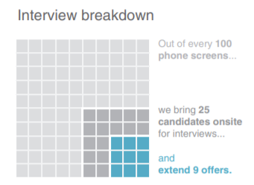
Square Area
Try to avoid square area unless when you need to visualize numbers of vastly different magnitudes.

Slide 20

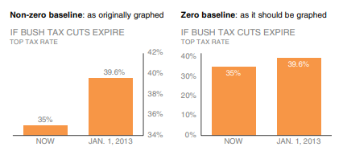
Ethics and Data Visualization
Intentional or unintentional use of deceptive techniques with the potential of altering the audience's understanding of the information being presented.

Slide 21
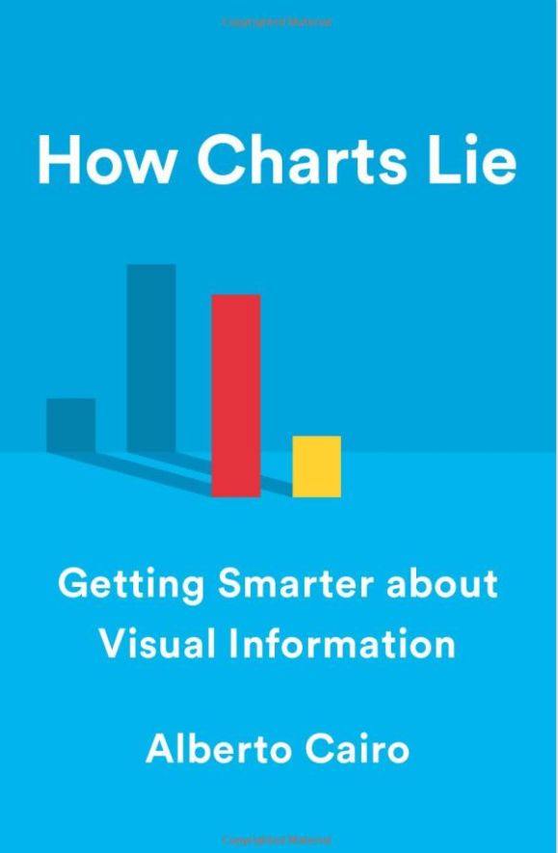
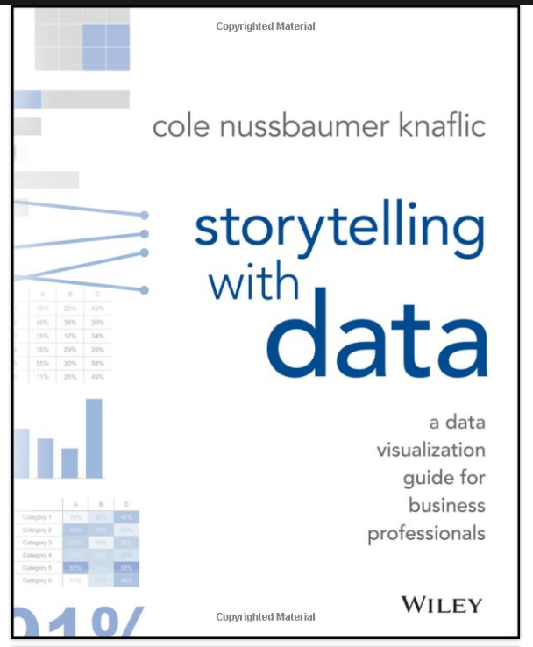
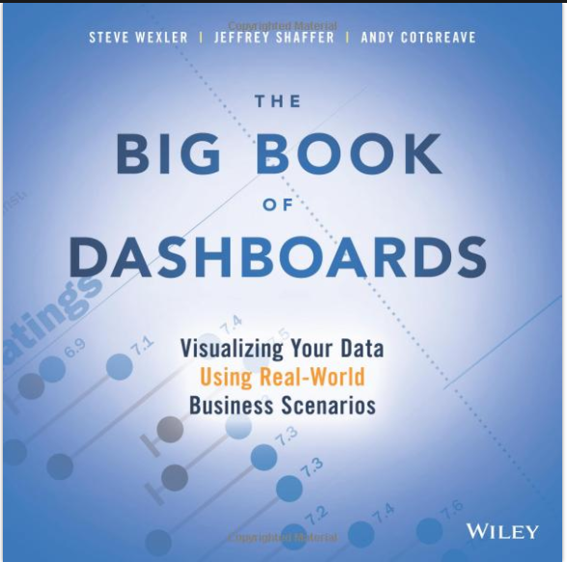
Books for Data Visualization

Slide 22
Reference
Knaflic,Cole, N. (n.d.). Storytelling with data A data visualization guide for business professionals. Wiley & Sons.
Zhang, J. (2020, September 23). What Do You Want to Say With Your Data | Institute without Boundaries Workshop 2020 [Video]. YouTube. https://www.youtube.com/watch?v=6Stkd2O8gRc

